Slide 1
Tableau Tutorial
Sulekha Aloorravi

Slide 2
Day2

Slide 3
Creating multiple histograms

Slide 4
Multiple charts – Distribution of Heights and Weights of NBA players?

Slide 5
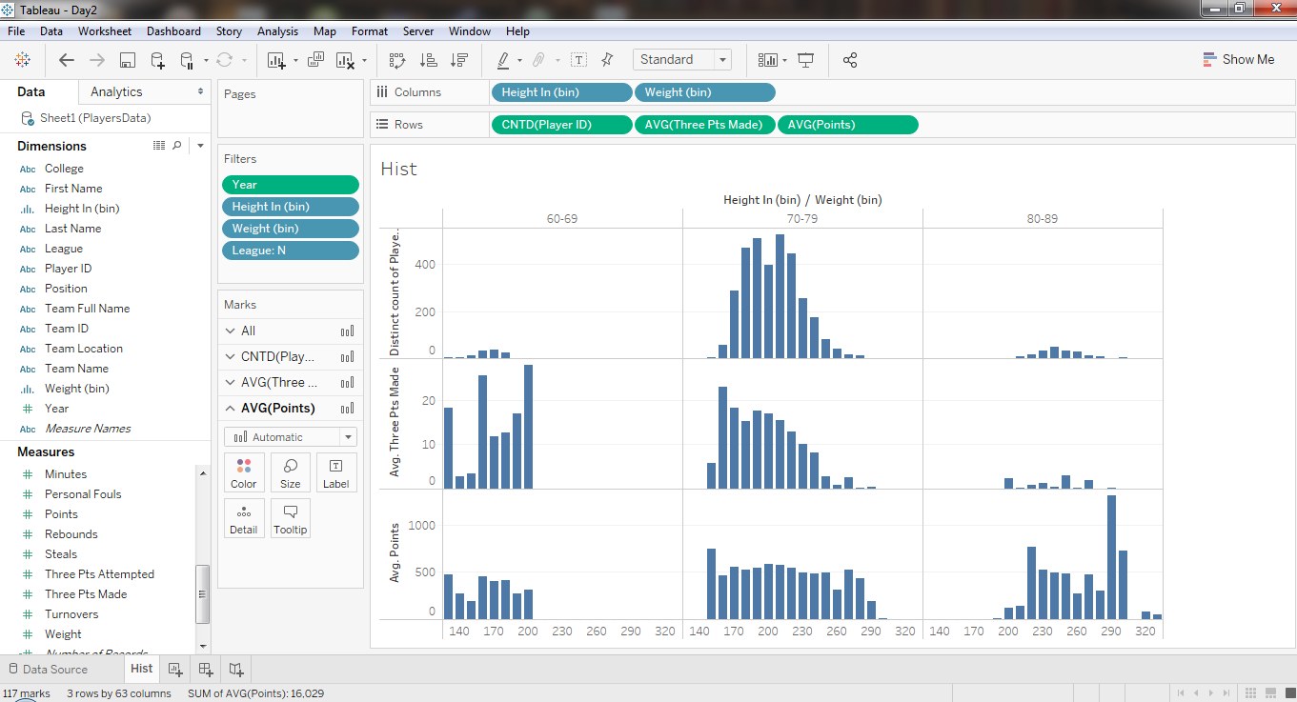

Slide 6
Creating small multiple area charts

Slide 7
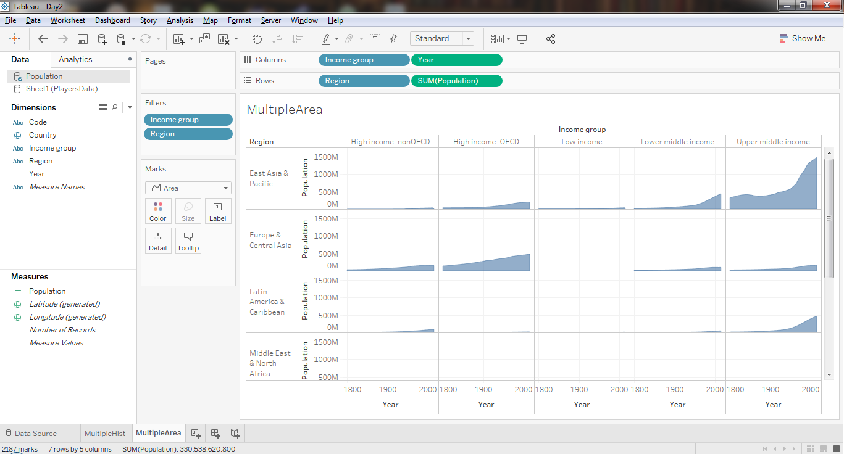

Slide 8
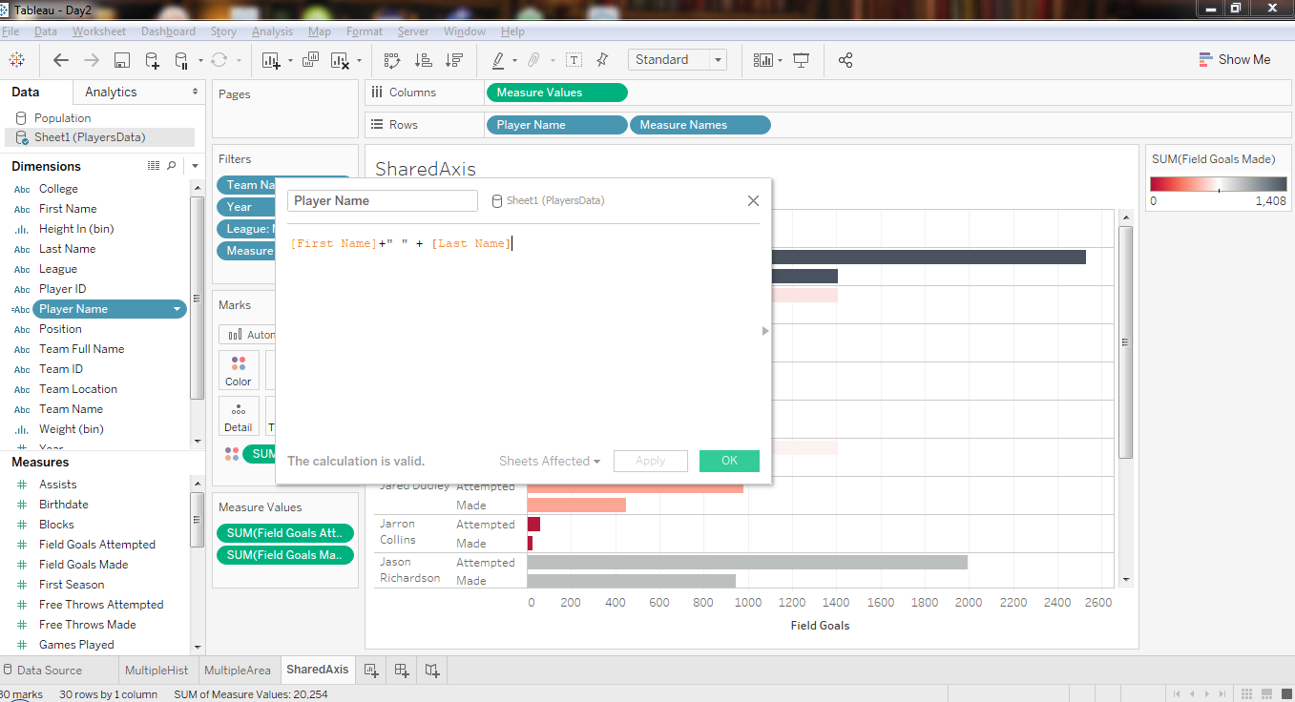

Slide 9
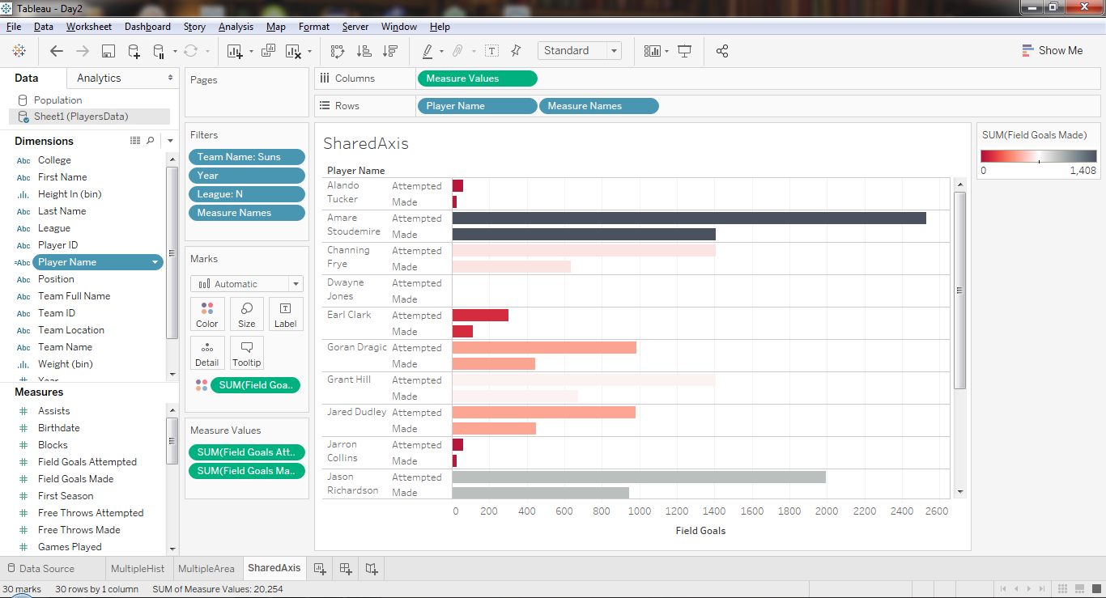

Slide 10
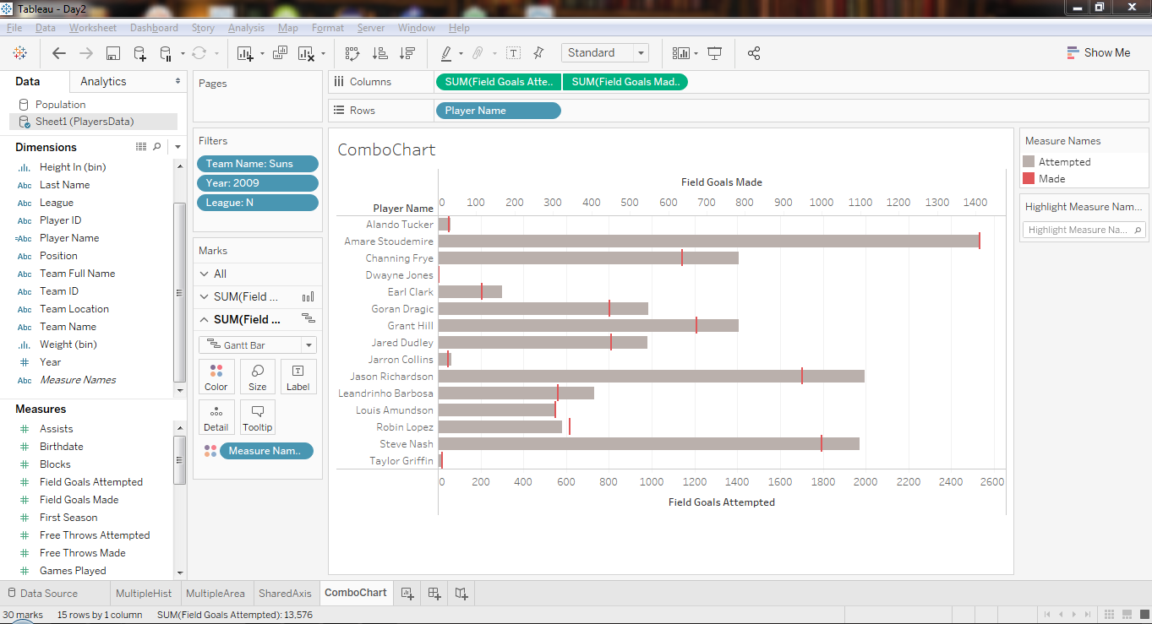

Slide 11
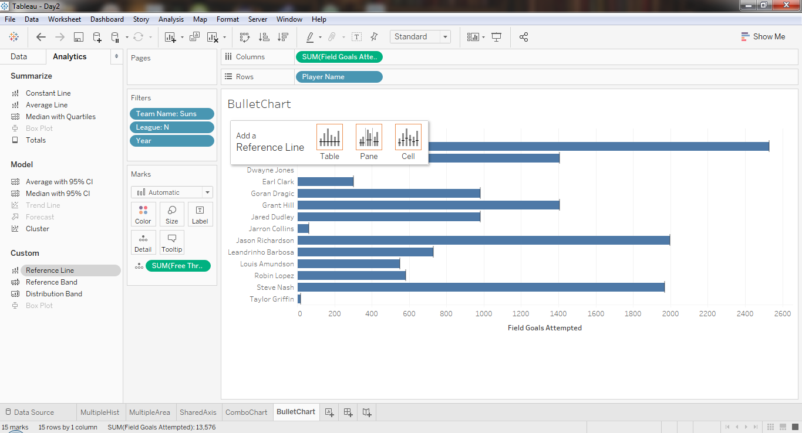

Slide 12
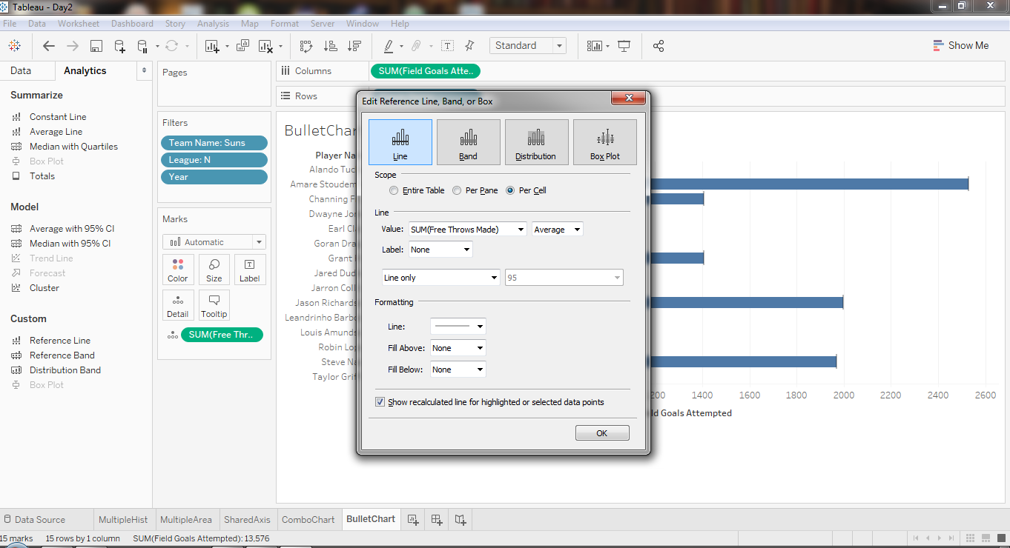

Slide 13
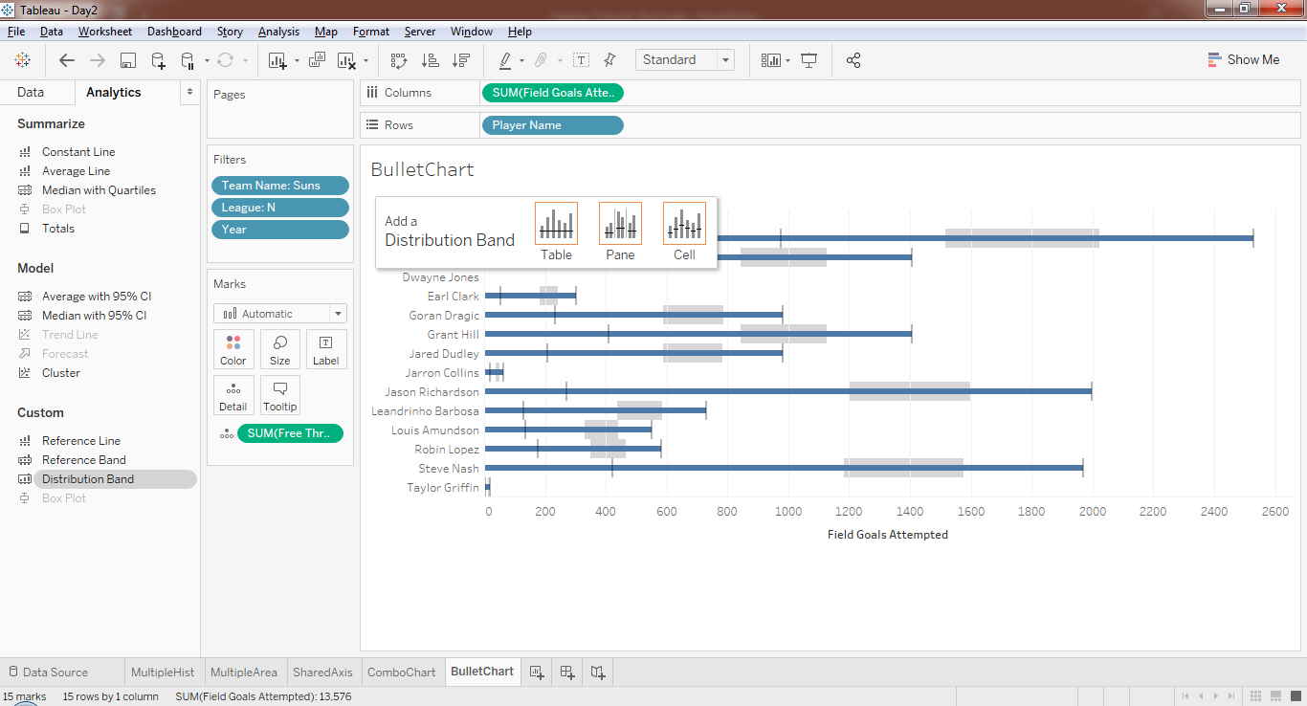

Slide 14
